Slide 1


2025. 09. 25. THU
Sookmyung Women's University Graduate School
2025 Autumn Winter
Online Department Information Session
Department of English Language & Literature
2025-2 전기 숙명여대 일반대학원 온라인 학과 설명회 - 영어영문학과

Slide 2
Table of Contents
1
Department Introduction
Faculty
Introduction
Graduation requirements
Research Activity Support for Graduate Students
Graduate Research Colloquium
Discussion
Session

Slide 3


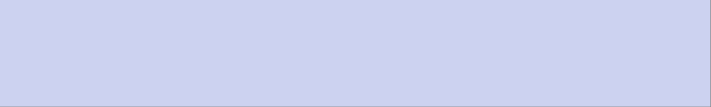
Department Introduction
2
English
Literature
Major
English
Linguistics
Major
Translation
Studies
Major
Dep. of
English language
& Lit.
TESOL
(Ph.D.)
The Department of English Language & Literature consists of four subfields.
Master's students in their second semester and Ph.D. students in their first semester
can select their subfields.
TESOL(Teaching English to Speakers of Other Languages) is available at the Ph.D. level.

Slide 4







Course Overview
5
English Literature Major
1
Key strengths of department
2
Subjects
Anglo-American Literature Seminar, Understanding Modern American Fiction, Understanding Modern British Fiction, Studies in Anglo-American Children's Literature, Theory and Practice of Film Criticism, History of Anglo-American Literary Criticism
- Analyzing Anglo-American literature and culture.
- Strengthens humanities knowledge, language skills, literacy, and academic writing.
3
Career Pathways
Pursuing doctoral programs, working in research institutes, educational institutions, foreign companies, or in the field of popular culture criticism

Slide 5
Course Overview
3
English Linguistics Major
- Syntax/Morphology, Phonetics/Phonology,
Applied Linguistics, Brain-Based Language Education, Digital Literacy, ect.
1
Key strengths of department
2
Subjects
Specialized courses for professionals in English education and linguistics
Designed to enhance linguistic and humanistic knowledge
Incorporates discussions and seminars for deeper engagement
3
Career Pathways
- Ph.D. in Korea or foreign countries
English teacher
Researcher in English education
Careers in multinational conglomerates

Slide 6
Course Overview
4
Translation Studies Major
1
Key strengths of department
2
Subjects
Transcreation, Translation Quality Assessment, Translation Seminar, Professional Translation Practice, Understanding the Localization Industry, Literary Translation,
Theory and Practice of Translation.
-Develops academic and practical translation skills, including localization strategies for cultural and market needs.
3
Career Pathways
Translator, Translation Quality Manager, Post-Editor, Proofreader, Reviewer

Slide 7
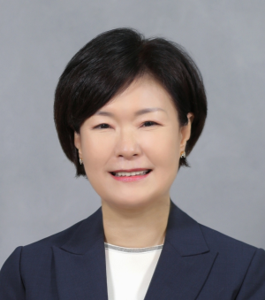
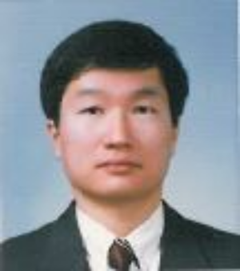
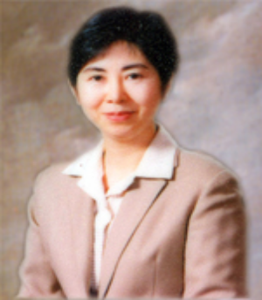
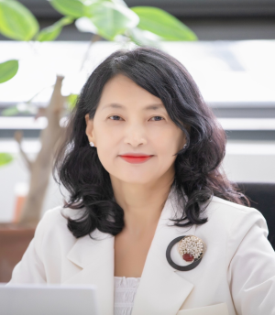
Faculty Introduction
6
English Linguistic Major
Sookhee Lee (Professor)
Field: Syntax, English Linguistics, Linguistics
Sechang Lee (Professor)
Field: Phonology, English Linguistics, Linguistics
Aejin Kang (Professor)
Field: English Education/TESOL
Myunghee Kim (Professor)
Field: English Education/TESOL

Slide 8

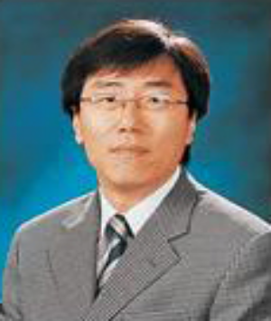
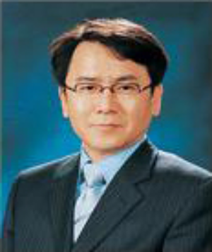
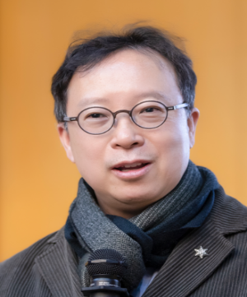
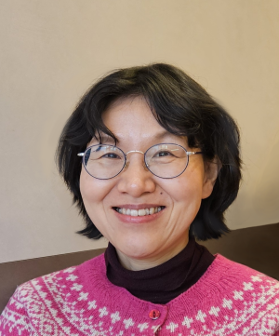
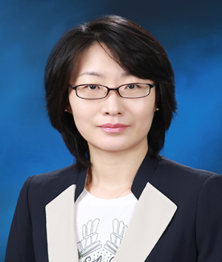
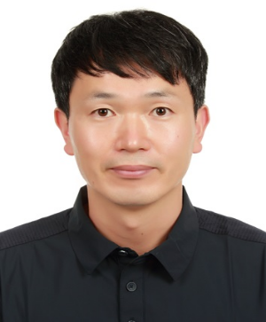
Faculty Introduction
7
English Literature Major
Inchan Park (Professor)
Field: American Literature, Modern Fiction,
Science Fiction (SF), Posthumanism
Gyounghoon Yoo (Professor)
Field: English Literature, Theory, Criticism
Sehjae Chun (Professor)
Field: English Literature, Ecocriticism, Korean Studies
Sojin Park (Professor)
Field: Anglo-American Children's and Young Adult Literature Criticism, Comparative Children's and Young Adult Literature, Mythology and Religious Literature, Folklore and Cultural Studies
Sunghee Yook (Professor)
Field: Anglo-American Women's Literature, Women's Studies/Gender Studies, Asian American Literature
Inshik Bang(Associate Professor)
Field: Autobiography, Comic Studies, New Media Narratives

Slide 9
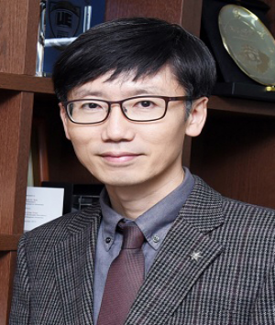
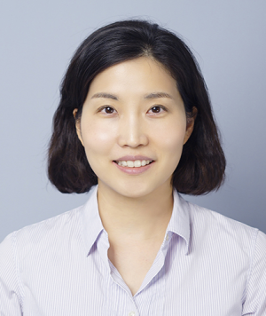
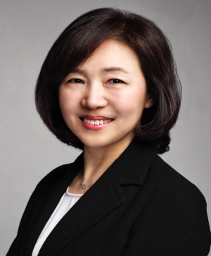
Faculty Introduction
8
Translation Studies Major
Hyung-jin Lee (Professor)
Field: Translation Studies, Comparative Literature
Eunseon Chung (Assistant Professor)
Field: Translation Studies, Linguistics
Soonmi Kim (Associate Professor)
Field: Translation and Interpretation

Slide 10
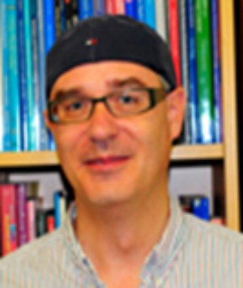
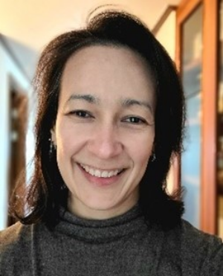
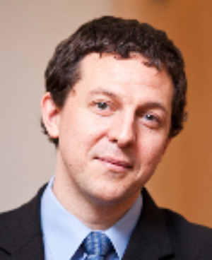
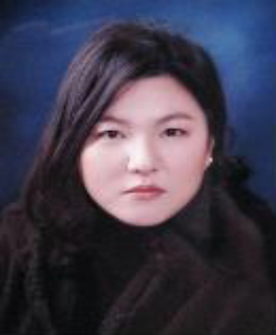
Faculty Introduction
9
TESOL Ph. D. Major
Aejin Kang (Professor)
Field: English Education/TESOL
Van Vlack (Assistant Professor)
Field: TESOL Major, Applied Linguistics
Myunghee Kim (Professor)
Field: English Education/TESOL
Diane Rozell (Assistant Professor)
Field: TESOL Major
Nevin Liddy (Assistant Professor)
Field: English Linguistics,SLA, TESOL
Jiyoung Ha(Adjunct Professor)
Field: TESOL, English Education,
English Linguistics

Slide 11

Graduation Requirements
10
*All of the steps are essential for graduation
1. Credit requirements
2. Research Ethics and Thesis Writing
3. English Examination
4. Comprehensive Examination
5. Thesis / Dissertation
*Required Courses
-Literature Major: Introduction to British and American Literature
-Linguistics Major: Choose one – Studies in English Linguistics or Introduction to English Linguistics
-Translation Studies Major: According to the current department regulations,
No required courses have been designated.

Slide 12
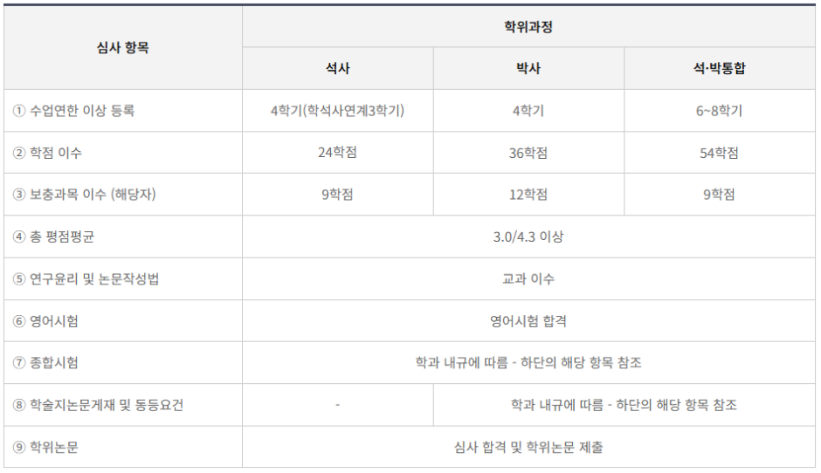
Graduation Requirements
11
*Specifications for graduation requirements.
(All of the information are available in the Sookmyung Graduate School website.

Slide 13
Research Activity Support for Graduate Students
12
Support is available for those who present papers at domestic and international academic conferences or publish papers in journals indexed by the Korea Citation Index (KCI, candidate journals included) or international academic journals (A&HCI, SSCI, SCOPUS), as detailed below.
During the enrollment period, support is provided for up to two journal publication fees and up to two conference presentations.
1. Eligibility
Master’s students: Enrolled or within one year of program completion.
Doctoral students: Enrolled or within three years of program completion.
First author (or corresponding author): If there are co-first authors,
support is available only if the applicant can provide justification for their higher contribution.
*If a faculty member is included as a co-author, support is not available.
*If publication fees are covered by faculty research grants or other funding sources, duplicate support is not allowed.

Slide 14
Research Activity Support for Graduate Students
13
2. Support Details
Publication fees : 200,000won (for each publication)
Conference presentation fees: KRW 50,000 per presentation.
*Each individual can receive support for up to two publications and two conference presentations.
3. Application Period
- Within three months of paper publication.
- From the second semester of the 2024 academic year until funds are exhausted.

Slide 15
Research Activity Support for Graduate Students
14
4. Required Documents
Applicants should submit only the relevant document based on their application type (publication fee support or presentation fee support).
[Application for Publication Fee Support]
-Research Activity Support – Publication Fee Application Form (Handwritten signature required) [Download Form (LINK)]
-Published Paper
-Invoice for Publication/Review Fees (issued by the academic society)
-Receipt for Payment of Publication/Review Fees (issued by the academic society)
-Proof of Bank Transfer (showing payment made from the applicant's own account)
[Application for Conference Presentation Support]
-Research Activity Support – Presentation Fee Application Form (Handwritten signature required) [Download Form (LINK)]
-Conference Schedule
-Conference Proceedings
-Presentation Materials

Slide 16
Research Activity Support for Graduate Students
15
5. Submission Methods
1) In-Person Submission: Department of English Language and Literature Office (Jilli Hall, Room 303)
2) Email Submission: grad-english@sookmyung.ac.kr
File Naming Format: Name(Student ID)_File Name
6. Contact Information
📧 Email: grad-english@sookmyung.ac.kr
📞 Phone: +82-2-710-9376
※ Please note that support approval is subject to internal department review.

Slide 17

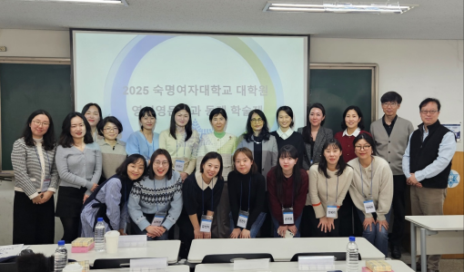
Graduate
Research Colloquium
16
Held in twice in a year
(Feb. and Aug.)
- Conducted separately by majors
Graduation Thesis Proposal
After the proposal, preliminary examinations
and the defense are conducted.
Special lectures and professors’ feedback
are provided
Enhances academic communication
And expands academic network

Slide 18

Discussion Session
17
Q & A

Slide 19

Sookmyung Women's University
General Graduate School
Thank you!
: 미리교육청 김미리 주임
Contact Information
*Email: grad-english@sookmyung.ac.kr

